Slide 1
Express best Practices

Slide 2
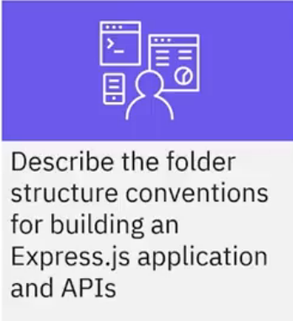
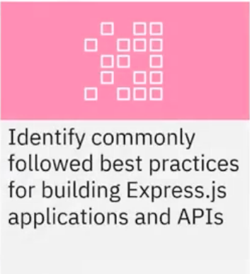
What you will learn

Slide 3

Web framework directory structures
• Most web frameworks have required
directory structures
• Express does not require a particular
directory structure
• Best to define a structure in advance for
growth and maintenance

Slide 4
Suggested Express folder structure
Project
Node_ module
models
config
routes
views
Public

Slide 5
Node modules folder
Node modules
• Contains application's modules
and packages
• Automatically created after
running the npm install
command

Slide 6
Config folder
Config
• Contains configuration files
such as
Database connections
Environment variables
Credential files including API keys
for external services

Slide 7
Models folder
Models
• Contains data models
• Data models specify the type of
data store defined by an ORM
library

Slide 8
Routes folder
Routes
Specifies routes for all entities
One file for each logical set of
routes

Slide 9
Views folder
Views
• Contains templates
• Templates dynamically write
HTML, CSS, and JavaScript for
the client

Slide 10
Public folder
Public
• Contains static content such as
images, CSS, and JavaScript
• Helpful to have a sub-folder for
each type of content

Slide 11

Project folder
Project
• Main configuration file
for your application
app.js
routes.js
package.json

Slide 12
Project folder
Project
Central location to access routes
Imports all files from routes folder
Exports them as a single module to app.js
Creates a single point of entry for all routes
app.js
routes.js
package.json

Slide 13
Project folder
Project
• Contains metadata used to manage dependencies
app.js
routes.js
package.json

Slide 14
API directory structure
Node modules
config
models
routes
app.js
routes.js
package.json

Slide 15
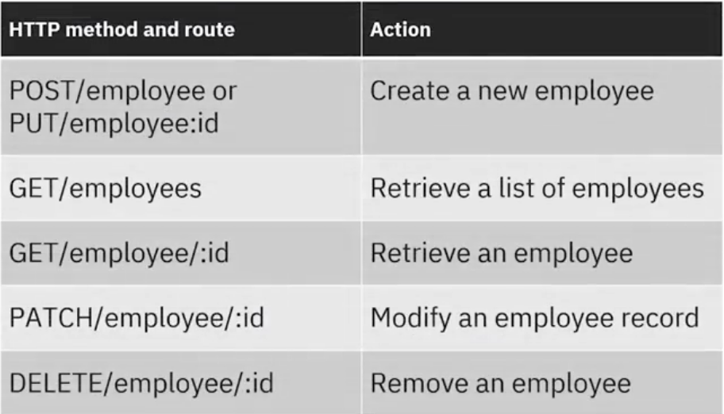
Naming routes

Slide 16
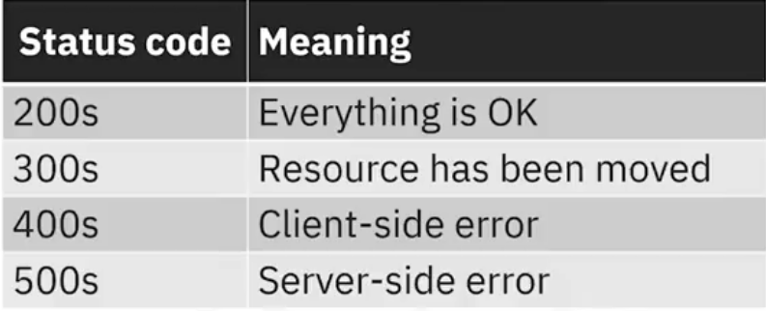
Using HTTP status codes

Slide 17
Testing REST APIs
• Black-box test REST APIs
• Test as a whole without
stubbed dependencies
Super Test
• Mocha framework contains
a module called Super Test
REST API
superTest

Slide 18
Testing REST APIs
• Black-box test REST APIs
• Test as a whole without
stubbed dependencies
Super Test
• Mocha framework contains
a module called Super Test
superTest
REST API

Slide 19

API authentication
• Use JWT based stateless
authentication
• User properties are provided on
the client-side

Slide 20

API documentation
• Provide appropriate documentation
for your REST APIs
• Documentation open-source
projects:
• API Blueprint (apiblueprint.org)
• Swagger (swagger.io)

Slide 21
Using Node Package Manager (npm)
Use npm init when initializing
Use--save or --save-dev When installing
The —-save and --Save-dev commands make sure correct dependencies are installed when moving to a different platform
Never push a node_modules repository
Always use npm to install packages

Slide 22
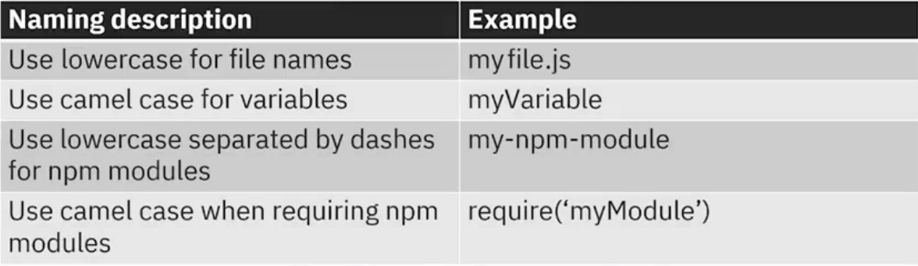
Naming conventions

Slide 23
Recap
In this video you learned that:
• Use a directory structure in both an Express.js application and an API that includes
node_modules/ config/, models/, and routes/ folders.
• Best practices when developing REST ful APIs include:
• Use a noun as a resource identifier
• Use HTTP status codes correctly
• Black-box test REST APIs using Super Test
• Use JWT-based stateless authentication
• Include good documentation
• Other tips include:
• Following capitalization conventions
• Use npm as recommended
• Use config files for variables and group similar functioning routes into their own files

